Slide 1
A brief Overview of Gene Co-Expression Network Analysis
Bioinformatics Applications (PLPTH813)
Sanzhen Liu
Most slides prepared by Cheng He
4/17/2025

Slide 2
Contents
Introduction of gene co-expression network (GCN)
Weighted Gene Co-Expression Network Analysis

Slide 3

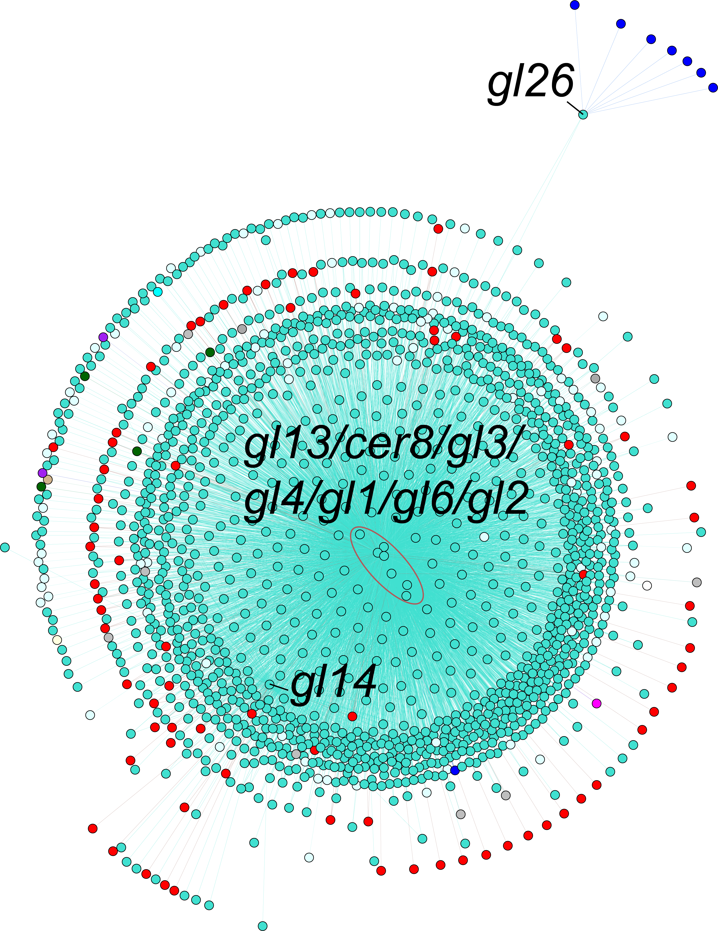
Wax biosynthesis genes are clustered closely in gene co-expression networks (GCNs)
Cheng He
GCNs were built using publicly available maize RNA-seq datasets (N=739)

Slide 4
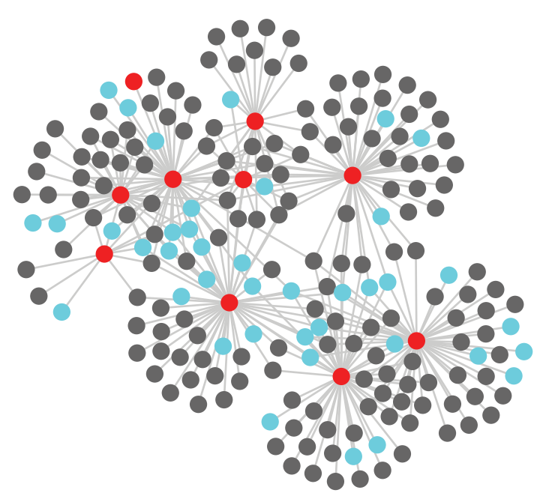
Gene co-expression network (GCN)
In a GCN, each gene corresponds to a node
Two genes are connected by an edge if their expression values are sufficiently similar
edge
node
Gene expression matrix
G1
Gene_ID | sample_1 | sample_2 | …...
G1 | 4 | 2 | xx
G2 | 0 | 3 | xx
G3 | 6 | 3 | xx
G4 | 10 | 5 | xx
…... | xx | xx | xx
 | xx | xx | xx
G4
Gene co-expression network analysis
Undirected network
G2
G3

Slide 5
Weighted and unweighted GCNs
Unweighted network
Weighted network
The adjacency values provides the connection strengths between gene pairs

Slide 6
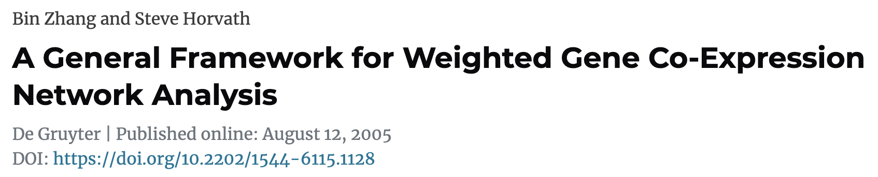
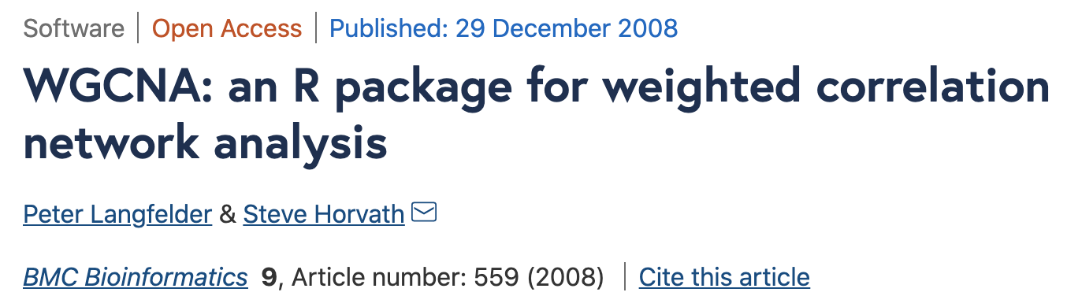
Weighted Gene Co-expression Network Analysis (WGCNA)
WGCNA is a popular gene co-expression network analysis method

Slide 7
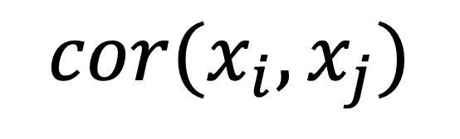
Similarity measure of gene expression
Pearson correlation can be used to measure the similarity of two gene expressions
Gene | s1 | s2 | …
Gi | 4 | 2 | …
Gj | 0 | 3 | …
$$cor(x_{i},x_{j})$$
Notes:
We denote the gene co-expression similarity measure of a pair of genes i and j by Sij. Many co-expression studies use the absolute value of the correlation as an unsigned co-expression similarity measure

Slide 8
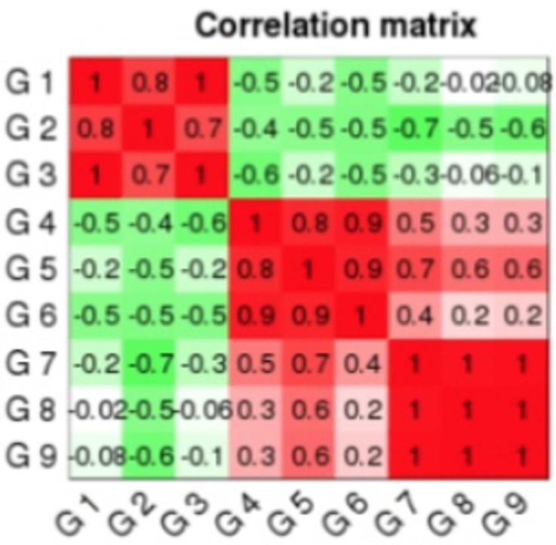
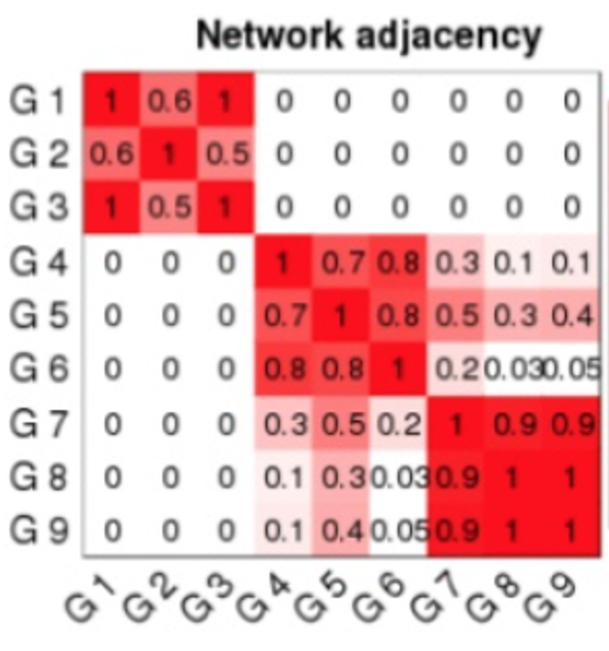

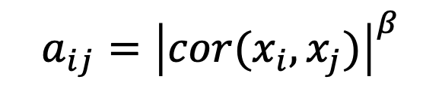
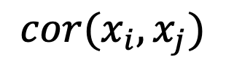
Using a power transformation softens weaker correlations and emphasizes stronger ones
$$✓$$
$${a_{ij}=\left|cor(x_{i},x_{j})\right|}^{β}$$
$$cor(x_{i},x_{j})$$
a_{ij}: the adjacency between genes i and j
β: soft thresholding parameter

Slide 9
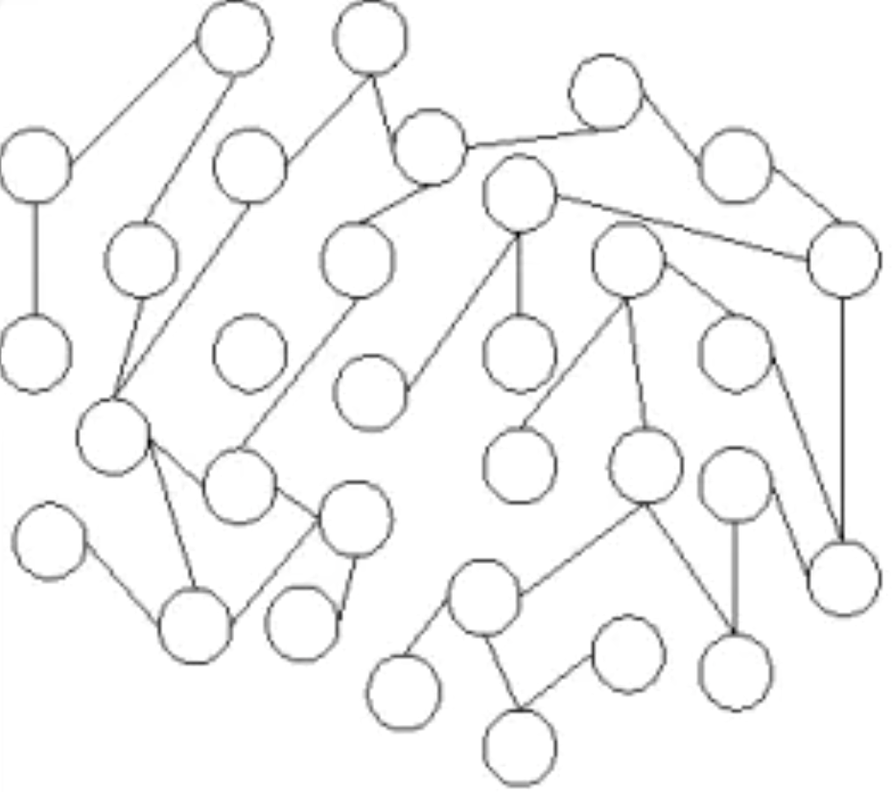
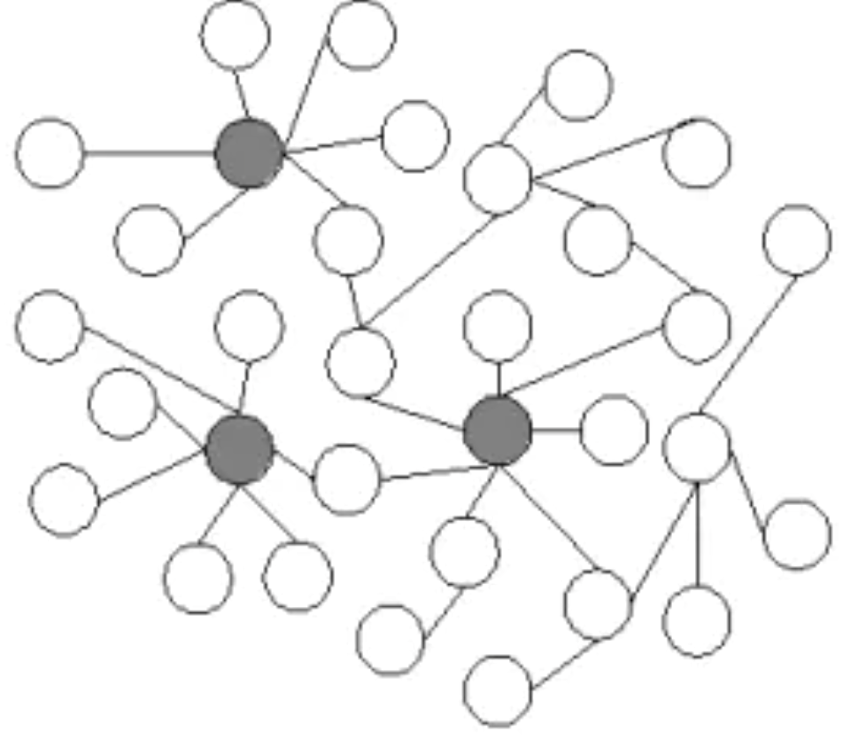
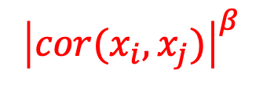
Define a soft thresholding power (β)
hub nodes
(a) Random network
(b) Scale-free network
$${\left|cor(x_{i},x_{j})\right|}^{β}$$
A scale-free network or topology means:
Most genes are only strongly connected to a few others
Only a few genes (called hub genes) are highly connected with many others, possibly playing central regulatory roles
Notes:
This mirrors real biology: gene regulation and interaction networks are not random — they are hierarchical and modular.

Slide 10
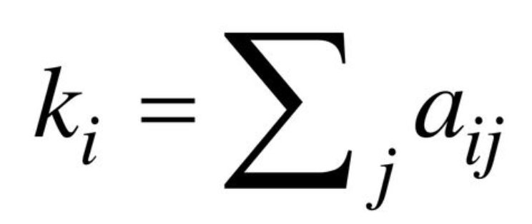
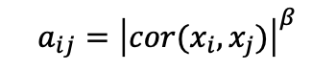
Generalized Connectivity
Gene connectivity = sum of the adjacencies of a gene
$${a_{ij}=\left|cor(x_{i},x_{j})\right|}^{β}$$
k_{i} : connectivity of gene i
a_{ij} : the network adjacency between gene i and j
High gene connectivity usually indicates a hub gene

Slide 11
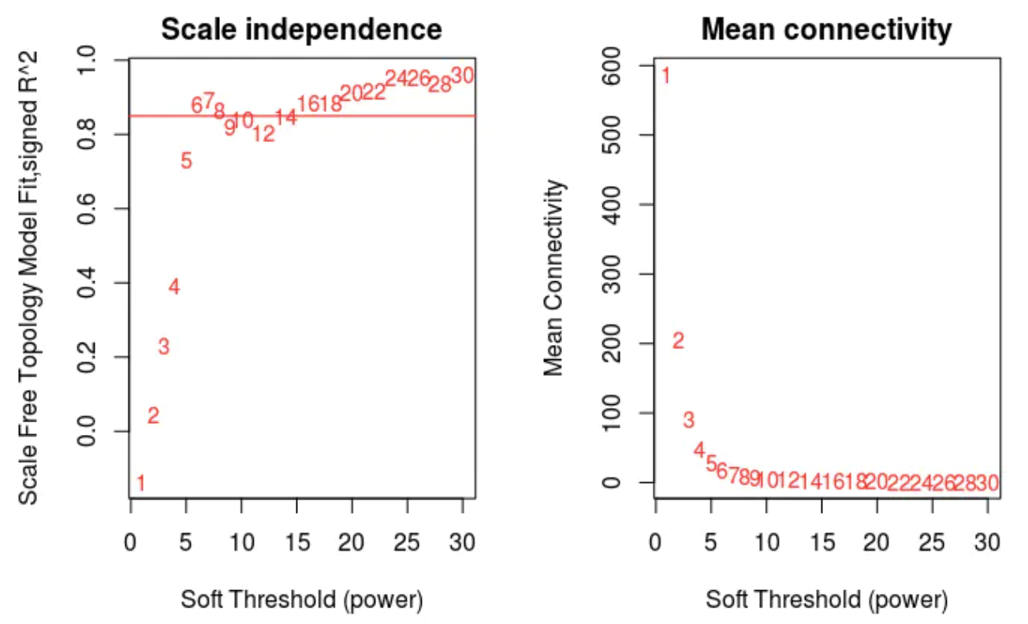
Define a soft thresholding power (β)
the scale-free topology model fit (R²)
An optimized β helps construct a network that satisfies the scale-free topology criterion, which is the lowest β value that leads to a high model fit (R2>0.8) and a low mean connectivity.
Notes:
There is a trade-off between high R2 value and high mean connectivity; a high model fit usually leads to a lower number of mean connections. A low mean connectivity may make module detection difficult, so both of these two parameters: scale free topology model fit and mean connectivity was taken into account when choosing the soft threshold power. Consequently, the lowest β value that leads to a R2 of 0.8 (or the highest possible model fit) was used.

Slide 12
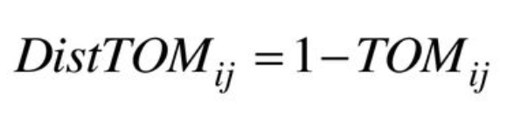
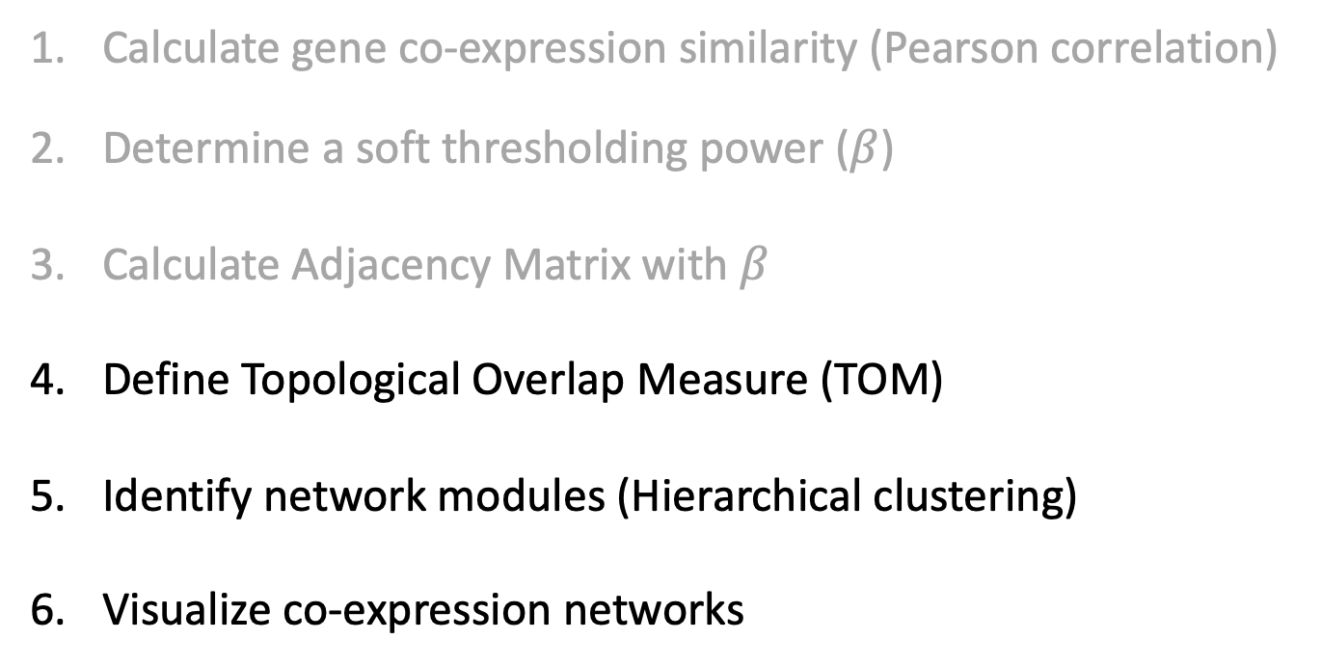
General Framework for WGCNA
Calculate gene co-expression similarity (Pearson correlation)
Determine a soft thresholding power ($β$)
Calculate Adjacency Matrix with $β$
Define Topological Overlap Measure (TOM)
Identify network modules (Hierarchical clustering)
Visualize co-expression networks

Slide 13
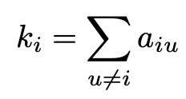
TOM
The topological overlap measure (TOM) combines the adjacency of two genes and connection strengths that these two genes share with other genes.
k_{i}: the connectivity of gene i
Notes:
The TOM combines the adjacency of two genes and the connection strengths these two genes share with other "third party" genes. The TOM is a highly robust measure of network interconnectedness (proximity). This proximity is used as input of average linkage hierarchical clustering.

Slide 14
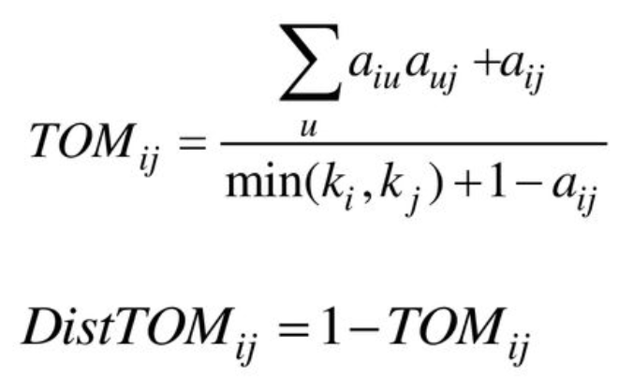
Define a Measure of Node Dissimilarity
G2
DistTOM = 0.8
G1
DistTOM = 0.1
G3
TOM describes the level of connection between a pair of two genes
A low value of distTOM indicates a high connectivity and a high value indicates a low or no connectivity.
Notes:
All entries in the TOM have a connection value to each other between 0 and 1, where a value of 1 meaning that all connections between two nodes and other nodes are the shared and 0 meaning that no connections to other nodes are shared

Slide 15
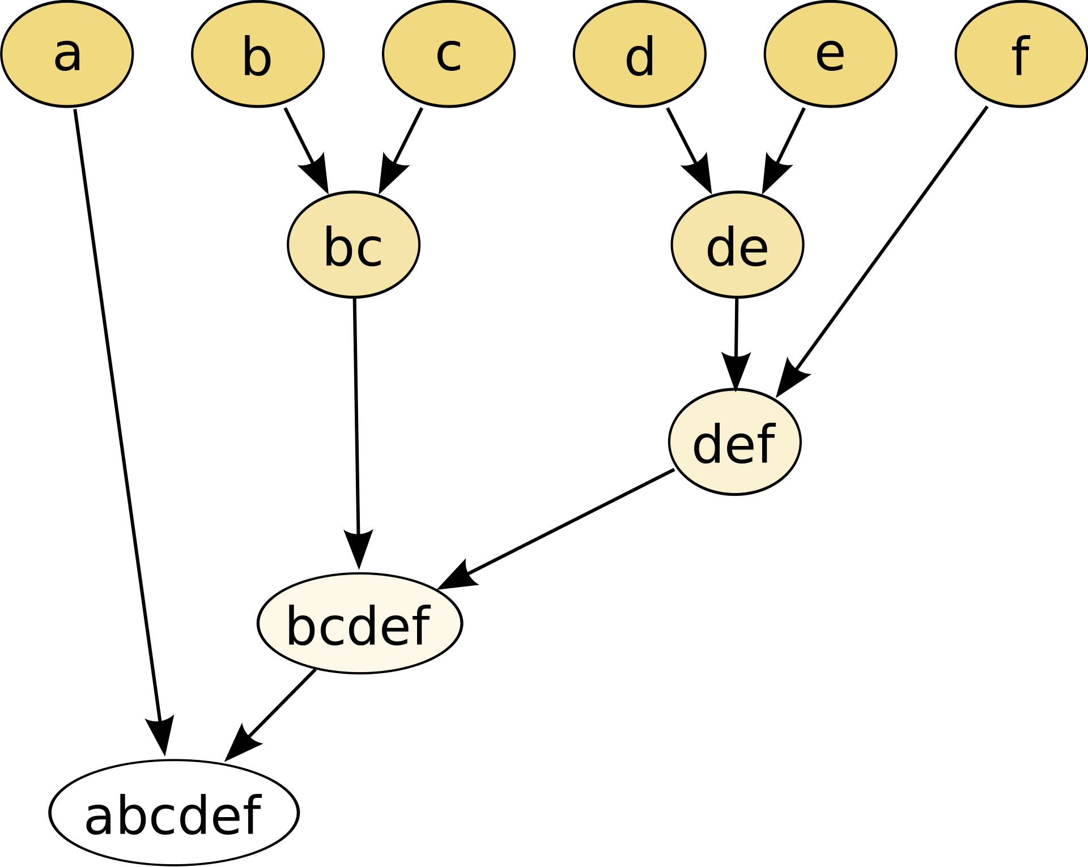
Identify Network Modules through hierarchical clustering
(https://en.wikipedia.org/wiki/Hierarchical_clustering)
Clustering using the distTOM matrix groups genes sharing many common neighbors into the same module.

Slide 16
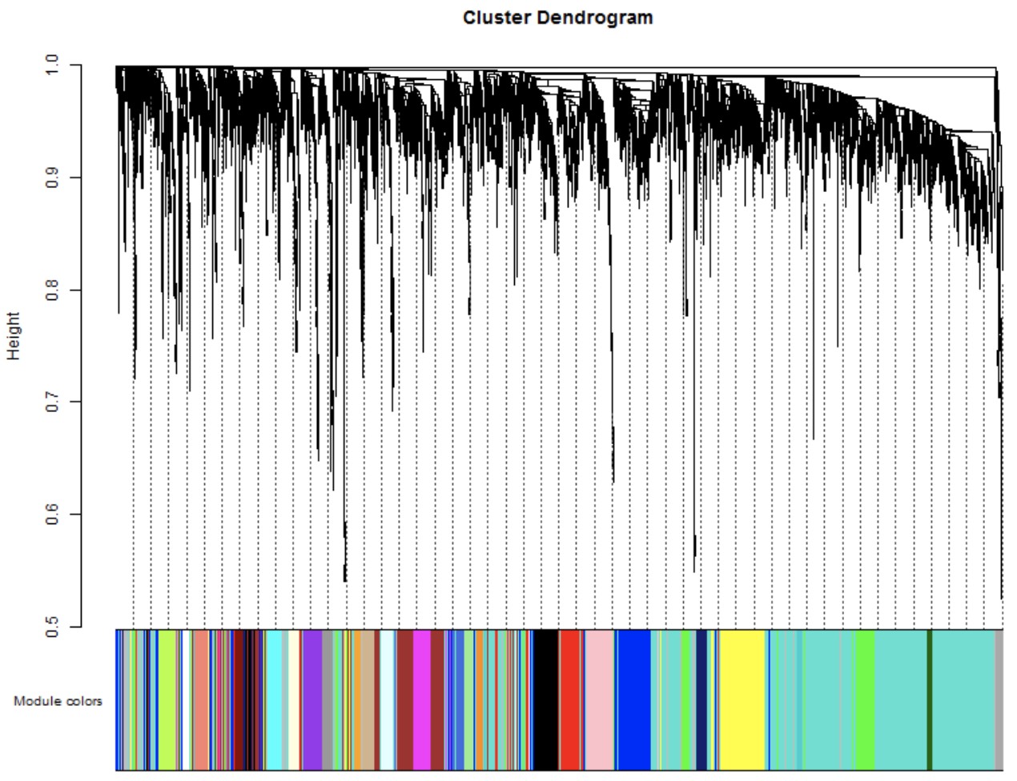
Hierarchical Cluster Dendrogram
distTOM
Module colors

Slide 17
Visualization of Co-expression network
Cytoscape (https://cytoscape.org)
Gephi (https://gephi.org/)
Notes:
In the heatmap, rows and columns correspond to single genes, light colors represent low topological overlap, and progressively darker orange and red colors represent higher topological overlap. The corresponding gene dendrograms and module assignment are shown on the left and top.

Slide 18
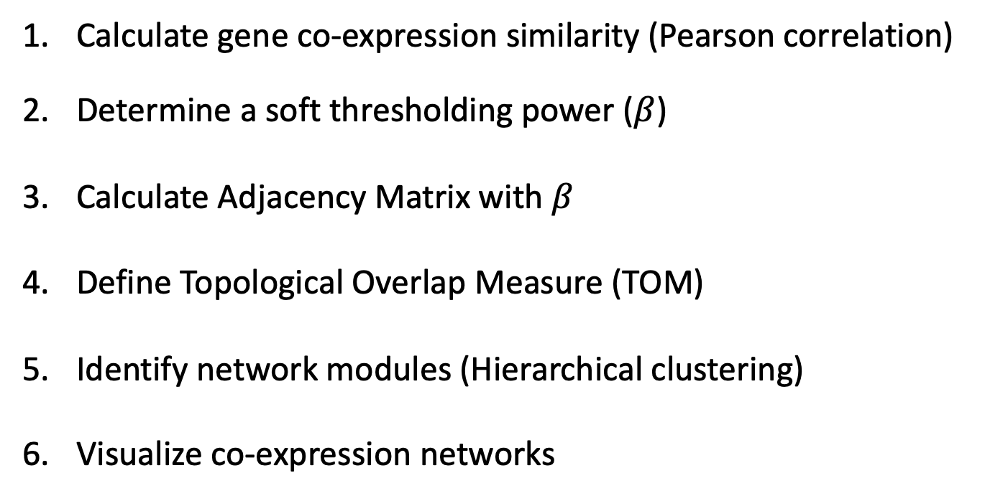
General Framework for WGCNA
Calculate gene co-expression similarity (Pearson correlation)
Determine a soft thresholding power ($β$)
Calculate Adjacency Matrix with $β$
Define Topological Overlap Measure (TOM)
Identify network modules (Hierarchical clustering)
Visualize co-expression networks

